Slide 1

Housing Our Future
Regional Strategy For Housing Affordability
Truckee Meadows, NV

Slide 2
About Enterprise
MISSION
LOCAL IMPACT
To create opportunity for low-and moderate-income people through affordable housing in diverse, thriving communities.
Total Enterprise Investment in NV
Over $88 million
Homes Financed
Over 1,100
Jobs Created
Over 2,200
Business Profits
Over $65 million
Federal, State and Local Tax Revenue
Over $66 million
EXPERTISE
Enterprise is the only housing organization in the U.S. with deep expertise in each of the three catalysts for systemic change:
  Solutions
  Policy
  Capital

Slide 3
Timeline
JAN 2017: Schwab Bank brings Enterprise to the Truckee Meadows region to facilitate a 1-day affordable housing forum
FALL 2017: TMHC & TMRPA enter into a formal partnership with Enterprise to develop a 10-Year Regional Strategy for Housing Affordability
FALL 2018: Completed Community Profile of regional housing needs and existing capacity
MAY 2019: Completed Truckee Meadow’s ten-year Regional Strategy for Housing Affordability, Housing Our Future

Slide 4

Process
Assess housing needs, market conditions, & local capacity
Develop strategy focus areas & supporting actions
Housing Our Future
Vet strategies with local stakeholders & residents
Establish a planning structure
Community Profile
+
Strategy Roadmap
+
Implementation Timeline
Community Profile

Slide 5
Community engagement
18
Working Group & Executive Leadership Team meetings
40+
One-on-one meetings with elected officials, industry groups, & other community leaders
130+
Survey responses
115+
Participants in community conversations & focus groups
10+
Presentations at community events (including RPC and RPGB meetings)

Slide 6
Planning structure
Executive Leadership Team
Working Groups
City of Reno
City of Sparks
EDAWN
Nevada Legislature
Nevada Housing Division
Regional Transportation Commission
Reno Housing Authority
Renown Health
Washoe County
ACTIONN
AGC
Bank of America
Builders Association of N.NV
Building & Construction Trades
City of Reno
City of Sparks
Chamber of Commerce
Charles Schwab
Community Health Alliance
Food Bank of N.NV
HOME Consortium
HUD
Krater Consulting
NAIOP
Nevada Housing Division
Nevada Legislative Counsel Bureau
Northern NV Community Housing
Northern Nevada Hopes
NNDA
NV Energy
Praxis
Regional Planning Commission
Regional Transportation Commission
Reno Housing Authority
Reno/Sparks Association of Realtors
Renown Health
Silver Sage
TMCC
Washoe County
Washoe County Health District
Washoe County School District
Wells Fargo
WNDD

Slide 7
VISION:
All residents of the Truckee Meadows should have access to a continuum of safe, accessible, and affordable housing options in neighborhoods that offer access to opportunity and a high quality of life.
PRESERVING AND CREATING QUALITY HOUSING OPTIONS FOR THE LOWEST END OF THE INCOME SPECTRUM
INVESTING IN HOUSING IN AREAS OF OPPORTUNITY
PRIORITIZING THE WORKFORCE AND POPULATIONS
AT-RISK OF HOMELESSNESS
PREVENTING HOUSING DISPLACEMENT
SUPPORTING MORE EFFICIENT LAND-USE THROUGH STRATEGIC INFRASTRUCTURE INVESTMENTS
BOLSTERING FINANCIAL RESOURCES AND TOOLS
EXPANDING STRATEGIC PUBLIC-PRIVATE PARTNERSHIPS
CORE PRINCIPLES

Slide 8
PART 1. COMMUNITY PROFILE
Understanding regional housing needs and capacity to respond

Slide 9
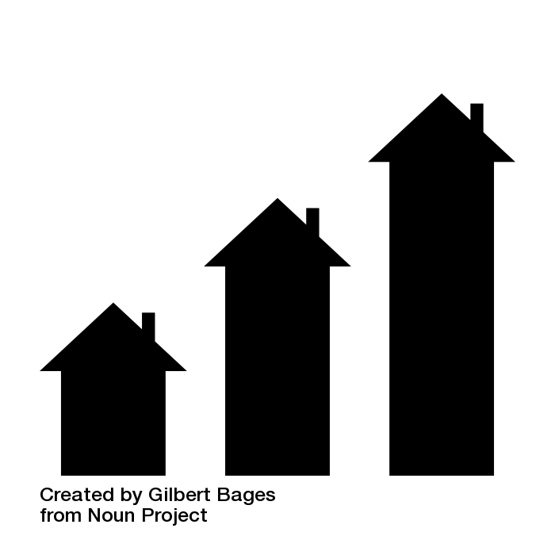




Key housing issues
There is a shortage of affordable rental units for low-income households in the region, particularly those earning less than 50% AMI
There are limited types of housing offered in the region today.
Incomes are not keeping up with housing costs, particularly home sale prices. As a result, many households are cost-burdened.
The region may lose some of its existing affordability due to deterioration of existing units and growing market pressures.
An increasing number of households face displacement pressures, due to expiring affordability and rising housing insecurity.

Slide 10
Regional capacity assessment
STRENGTHS Increased urgency in community conversation around affordable housing High capacity/MTW public housing authority Strong social services providers Local Master Plans support affordability Strong state-level resources | OPPORTUNITES State affordable housing committee Underutilized land Redevelopment of weekly motels Regional philanthropic community Economic development efforts & business owner engagement Regional Plan Update
WEAKNESSES Lack of funding Limited development capacity Siloed initiatives Limited coordination among jurisdictions Sequencing of funding applications Limited policy framework Infrastructure capacity | THREATS Tight housing market; expiring affordability Rising housing costs relative to incomes Limited types of housing available State property tax structure Shortage of construction workers/contractors Public misconceptions about affordable housing and who it serves

Slide 11
PART 2. STRATEGY ROADMAP
Overview

Slide 12
Building access to opportunity
Affordable Housing
Access to Jobs
Access to Services
Access to Quality Education
Access to Transit
Better Health Outcomes
Housing Security
Affordable Housing
Economic Growth & Mobility
Improved Regional Coordination
New & Expanded Public-Private Partnerships
Leveraged Policy and Funding Tools
Diverse Housing Options
Inclusive Communities
How does a Regional Housing Strategy benefit Truckee Meadows residents?
How does a Regional
Housing Strategy benefit the
Truckee Meadows
region?

Slide 13
Strategic framework
Cross-cutting Actions
Building the region’s capacity to address key housing needs
5 Strategy Focus Areas
Leveraging increased capacity to address targeted housing needs
10
Actions
Expanding the housing toolbox
Aligning cross-sector partners for regional impact
Targeting specific submarket conditions
Sequencing actions for implementation
25
Actions

Slide 14
Strategy focus areas
1
Support production of more rental housing that is affordable to low-income households, particularly those earning less than half of the area median income.
2
Support development of more diverse housing options for renters and homeowners throughout the region.
Cross-cutting actions
to support impleme-ntation
3
Help more residents access homeownership opportunities.
4
Preserve the affordability, while improving the quality, of existing affordable homeownership and rental options.
5
Protect residents from housing displacement.

Slide 15


Expanded housing toolbox
  NEW TOOLS
  NEW PROGRAMS
  Regional Housing Trust Fund
  State Housing Tax Credit*
  Section 108 Financing
  PACE financing
  Preservation early warning system
  Inclusionary housing policy
  Regional land/asset inventory
  Tenants’ bill of rights
  Public land disposition process
  Right of first refusal
Tenant-based rental assistance
Acquisition and rehab of tax delinquent properties
ADU pilot program
Preservation of rental housing
Regional down payment assistance
Employer-assisted housing
Regional homeowner rehab

Slide 16

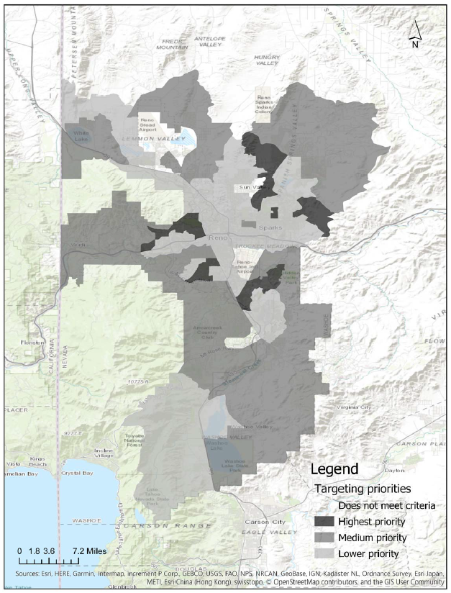
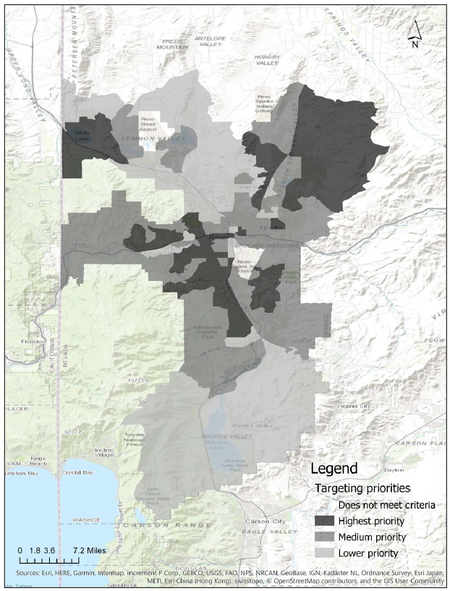
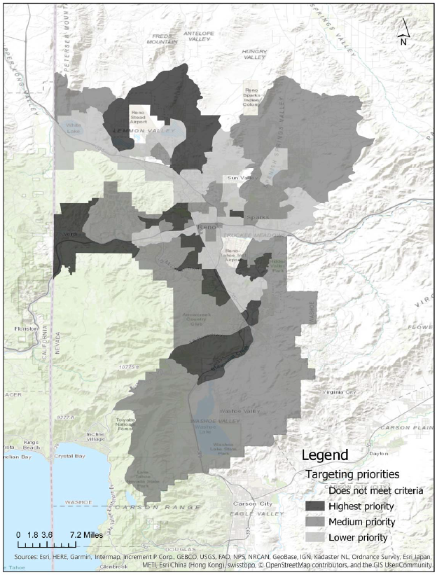
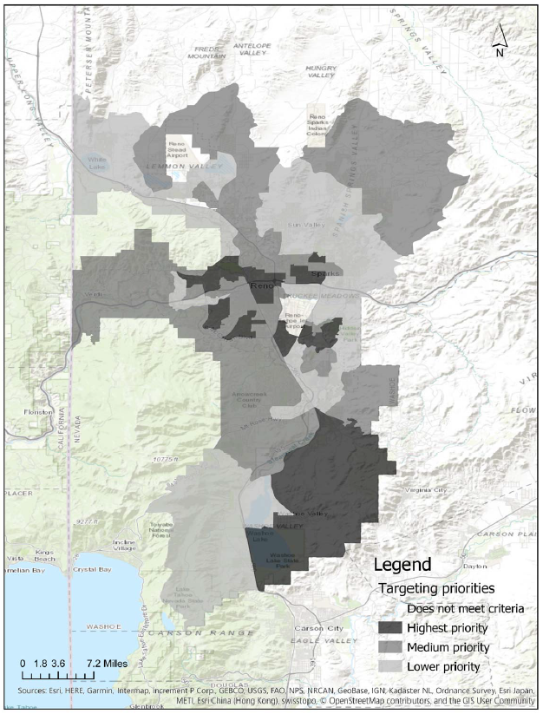
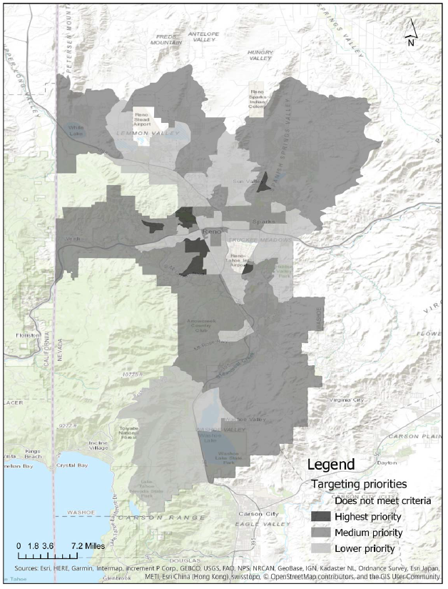
Targeting submarket conditions
  INDICATORS
Housing stock characteristics
Housing affordability
Investment & market conditions
Access to opportunity
Data sources: American Community Survey (2012-2016 5-year estimates); Comprehensive Housing Affordability Strategy (2010-2014 5-year estimates); Location Inc. (Q4 2017); PolicyMap (2015); TMRPA (2016 & 2018); Opportunity360 from Enterprise Community Partners

Slide 17
SHORT
(1-3 YEARS)
MEDIUM
(4-6 YEARS)
LONG
(7-10 YEARS)
Sequencing actions over ten years
Identifying a lead regional entity
Building capacity
Expanding financing
Strengthening systems
Updating regulations
Piloting innovative ideas
Continuing to build capacity
Increasing regional coordination
Launching new programs
Creating & expanding partnerships
Evaluating progress & adjusting strategies accordingly

Slide 18
Aligning partners for regional impact
Public sector
Private sector
Non-profits/ philan-thropy
More efficient regional housing delivery system
  AREAS FOR INCREASED REGIONAL COORDINATION
Communications & advocacy
Filling programmatic gaps
Increasing & administering funding/resources for affordable housing
Strengthening policies and processes

Slide 19
PART 2. STRATEGY ROADMAP
Targeted actions to address specific regional housing needs
City of Sparks

Slide 20
Build capacity for implementation & position the region for success.
HOW CAN THE CITY OF SPARKS ADVANCE THIS?
Support selection and capacity building for the lead regional housing entity | S
Apply for Section 108 Loan Guarantee Funds & identify appropriate administrator of those funds | S
Facilitate data-sharing with TMRPA (and other entities as needed) | S/M
Develop new regional policies and processes with the lead regional housing entity and other local governments to ensure a consistent and clear environment for development across the region | M
Support community education and outreach on housing issues | L
S = 1 to 3 years | M = 4 to 6 years | L = 7 to 10 years

Slide 21
1
Support production of more rental housing that is affordable to low-income households.
HOW CAN THE CITY OF SPARKS ADVANCE THIS?
Resource the Regional Housing Trust Fund | S
Identify approval processes to negotiate for affordability | S
Update development fee structures | S/M
Create standard incentive packages | M
Identify areas where affordability will be required, in addition to offering cost-offsetting incentives | L
S = 1 to 3 years | M = 4 to 6 years | L = 7 to 10 years

Slide 22
2
Support development of more diverse housing options for renters and homeowners throughout the region.
HOW CAN THE CITY OF SPARKS ADVANCE THIS?
Align zoning with Regional Plan Update | S
Evaluate opportunities within existing codes and development review processes to support a greater mix of housing types | S/M
Leverage green programming and blight remediation funds to support more diverse housing products | M
S = 1 to 3 years | M = 4 to 6 years | L = 7 to 10 years

Slide 23
3
Help more residents access homeownership opportunities.
HOW CAN THE CITY OF SPARKS ADVANCE THIS?
Support expansion of Community Land Trust model to homeownership | S
Help publicize information about supportive resources available for homeowners | M
Support re-establishment of regional down payment assistance program (at WCHC) | L
Support formation of employer-assisted housing programs | L
S = 1 to 3 years | M = 4 to 6 years | L = 7 to 10 years

Slide 24
4
Preserve the affordability, while improving the quality, of existing affordable homeownership and rental options.
HOW CAN THE CITY OF SPARKS ADVANCE THIS?
Establish a regional preservation process for properties flagged through the Nevada Housing Division | S
Establish local PACE program (building off Reno model) | M
Prioritize use of blight remediation assistance funds | M/L
Support new or expanded homeowner rehabilitation programming | L
S = 1 to 3 years | M = 4 to 6 years | L = 7 to 10 years

Slide 25
5
Protect residents from housing displacement.
HOW CAN THE CITY OF SPARKS ADVANCE THIS?
Pass legislation that requires all landlords to provide the “tenants’ bill of rights” document | S
Expand incentives for good landlords | M
Designate areas where additional incentives for preservation will be offered | M
Provide input on regional right of first refusal policy criteria and parameters | M/L
S = 1 to 3 years | M = 4 to 6 years | L = 7 to 10 years

Slide 26
Immediate regional implementation priorities
Based on feedback from the community & stakeholder working groups:
Confirm lead entity & build their capacity to guide implementation.
Dedicate funding for the Regional Housing Trust Fund.
Establish a preservation early warning system.
Apply for additional federal funding through the Section 108 Loan Guarantee Program.
Establish stronger incentives for inclusion of affordable units in market-rate development.

Slide 27

How can the lead regional housing entity help?
CURRENT STATE of the region’s housing delivery system
Limited resources spread across a variety of priorities
Siloed initiatives, lacking cohesive strategy
Reactive approach to market pressures
FUTURE STATE (as outlined in Housing our Future)
Expanded housing toolbox & more targeted deployment of resources
Robust coordination and collaboration across truly regional housing initiatives & strategies
Proactive approach to expand access to opportunity that is built to withstand changing market conditions
CHANGE AGENT
Clear, shared priorities and centralized administration of resources
Convener & coordinator with housing expertise that has jurisdiction across the region
Daily commitment paired with a long-range view on the region’s housing needs

Slide 28
Moving forward
Recommended Next Steps | Suggested Timeline
Review the roadmap with staff and agree to short-term actions and timeline | 1 month
Support RHA as the lead entity to drive implementation, including identifying key terms for this partnership | 3 months Capacity building & role definition to continue past this timeframe
Identify preferred process for continued regional coordination and refinement throughout implementation | 6 months

Slide 29
Moving forward
Recommended Next Steps | Suggested Timeline
Review the roadmap with staff and agree to short-term actions and timeline | 1 month
Support RHA as the lead entity to drive implementation, including identifying key terms for this partnership | 3 months Capacity building & role definition to continue past this timeframe
Identify preferred process for continued regional coordination and refinement throughout implementation | 6 months

Slide 30
Q&A / Discussion

